Slide 1
CIVIC VIRTUE
SADIYA P R
ECE-B

Slide 2
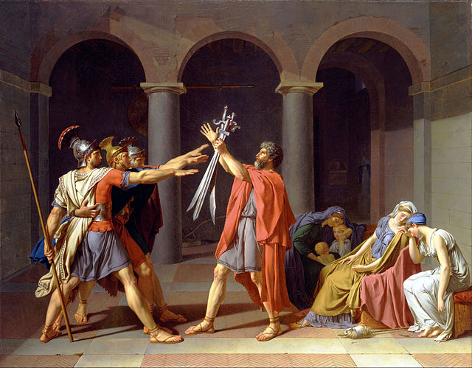













WHAT IS CIVIC VIRTUE?
Civic virtue is the morality or a standard Of righteous behavior in relationship to A citizen’s involment in society. An individual may exhibit civic virtue by voting,volunteering.organizing a book group,or attending a PTA meeting.
Putting the need of the country and its citizens above ones personal desires/wants

Slide 3
Civic virtues can be divided into four:
1.Civic knowledge
2.Self-restraint
3.Self-assertion
4.Self-reliance or Moderation

Slide 4
Civic Knowledge
Self-Restraint
Self-Assertive
Self-Reliance
Consists of political, historical and civic knowledge gained from both academic and engagment
It is the ability to control your emotions and actions. Self control.
Acts in a confident way,speaking firmly about their opinions and demanding the rights that they should have.
It is the ability to do things and make decisions by yourself, without needing other people to help you

Slide 5
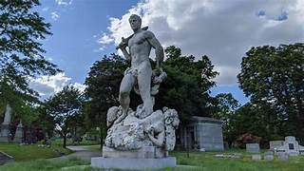
Civic Virtue Trimphant Over Unrighteousness (1909-1922) is a sculpture group and fountain in newyork,created by Frederick william

Slide 6
Thankyouu… And have a nice dayy

